Slide 1
Final Project Ideas
Katie Lau

Slide 2
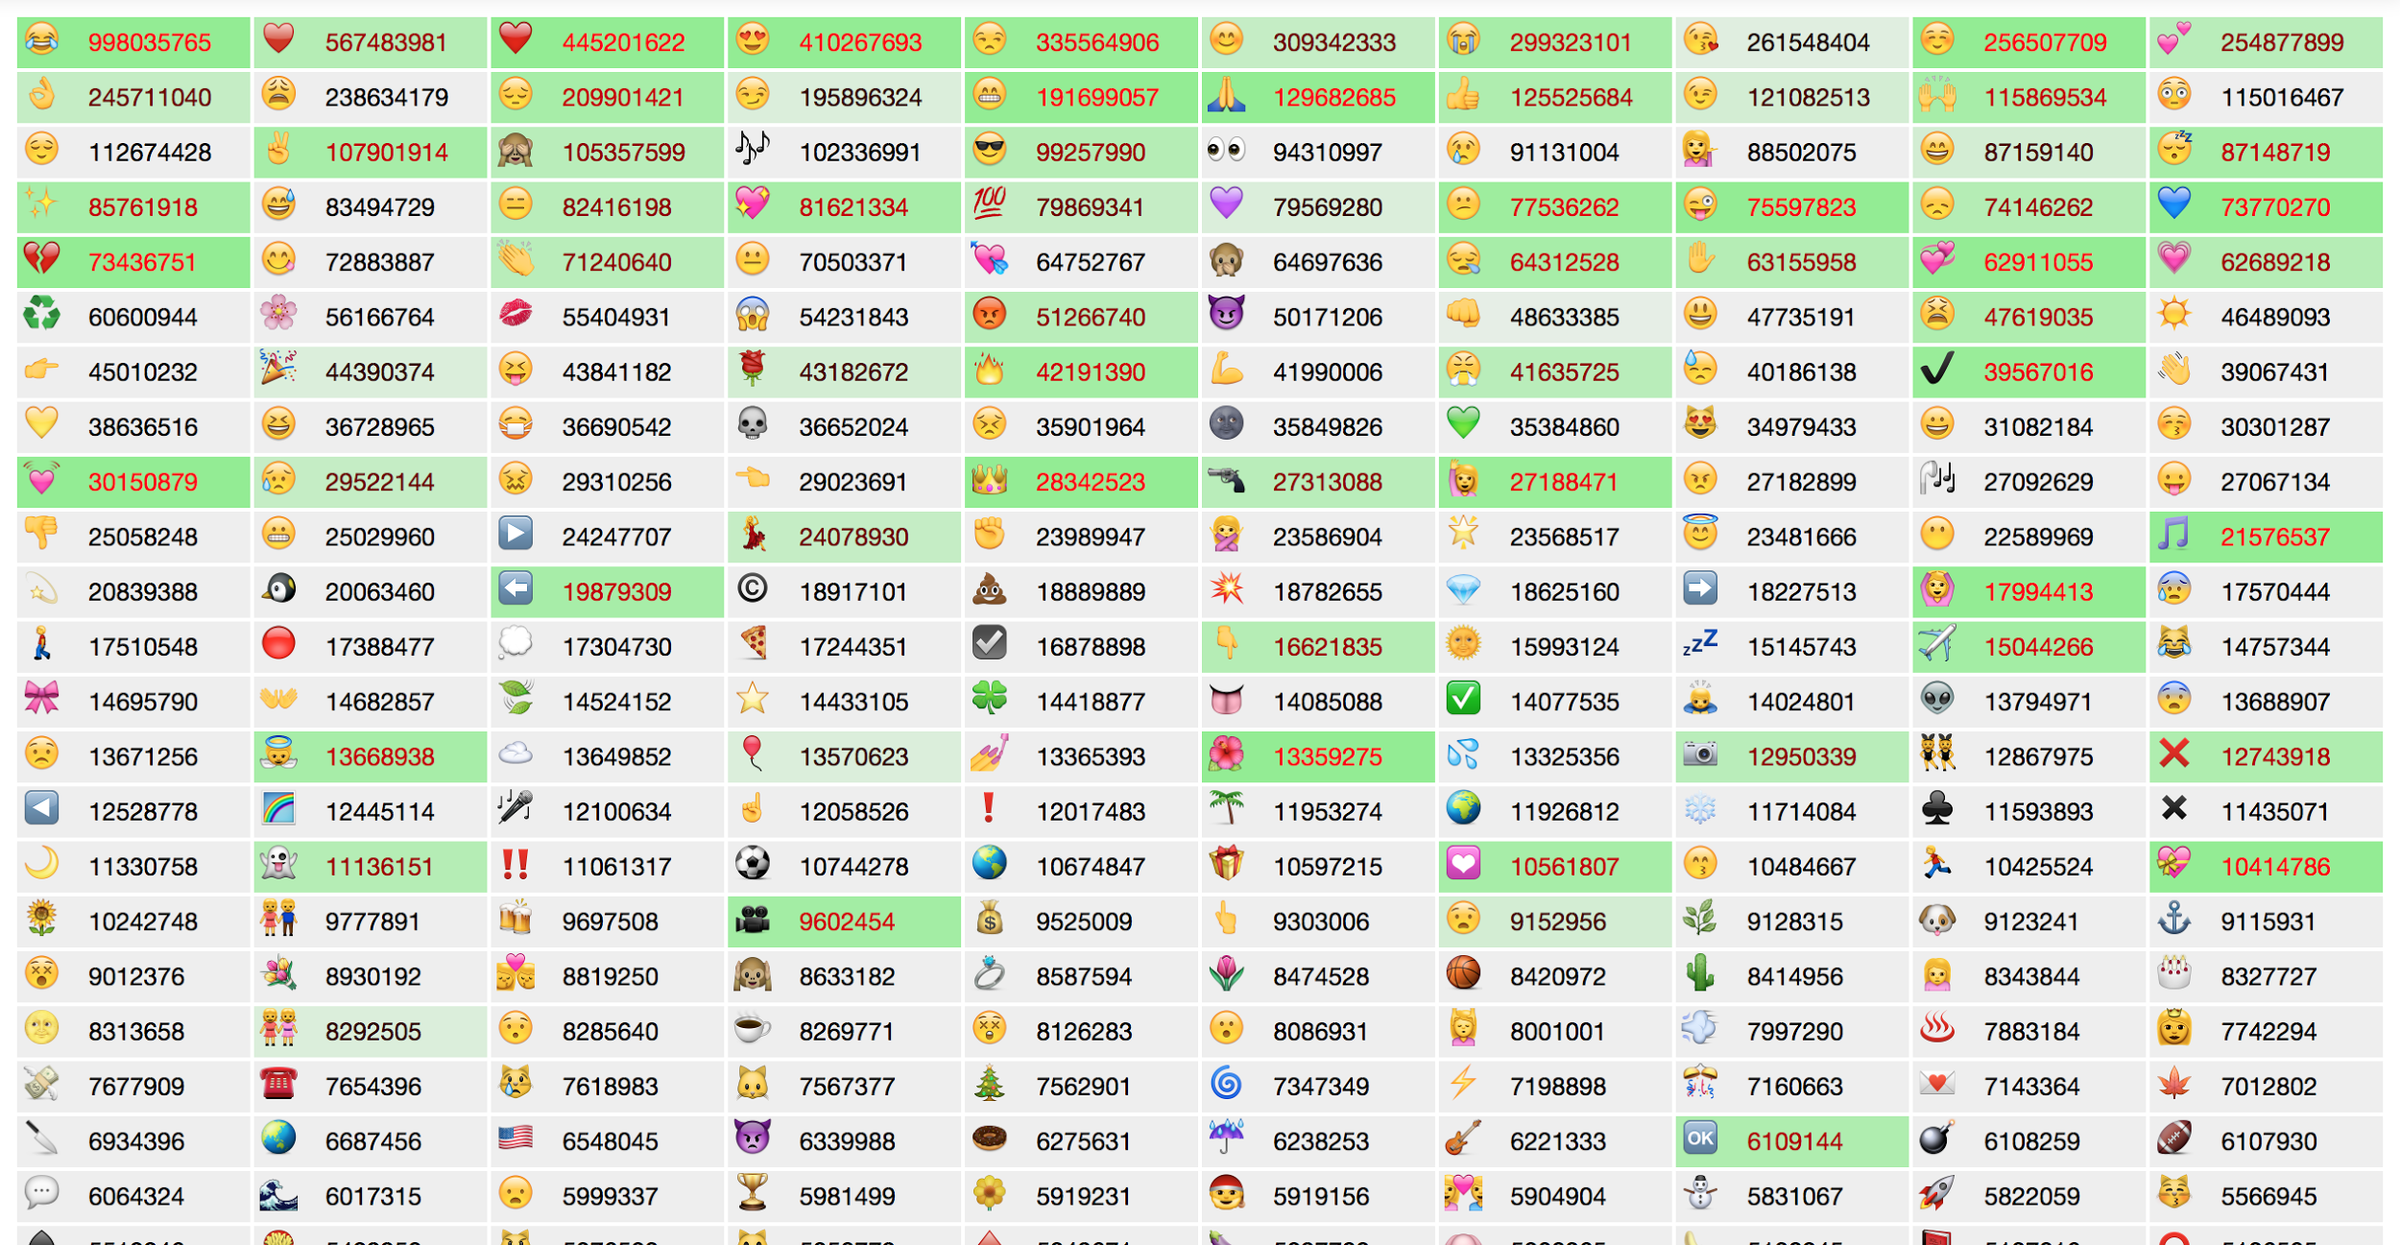
Visualization of Usage of Internet Memes

Slide 3
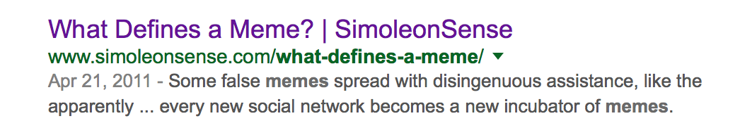


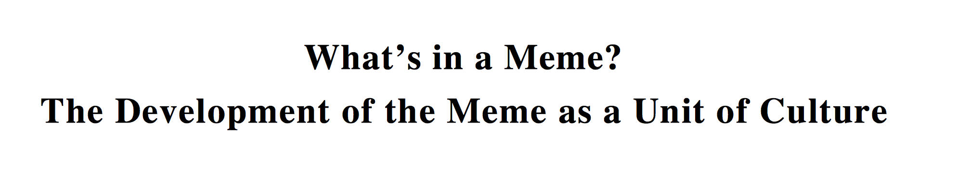
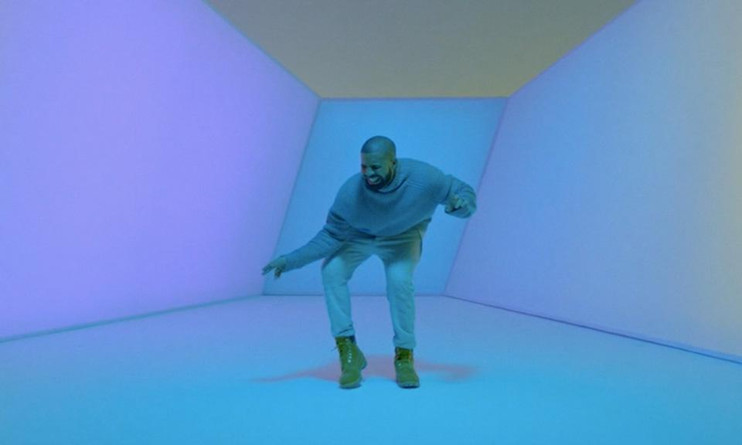


Slide 4
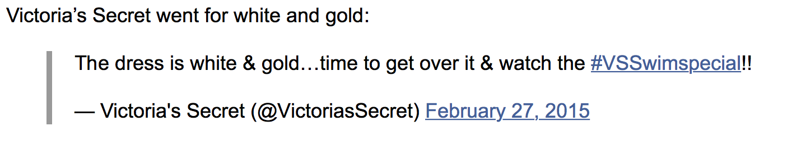
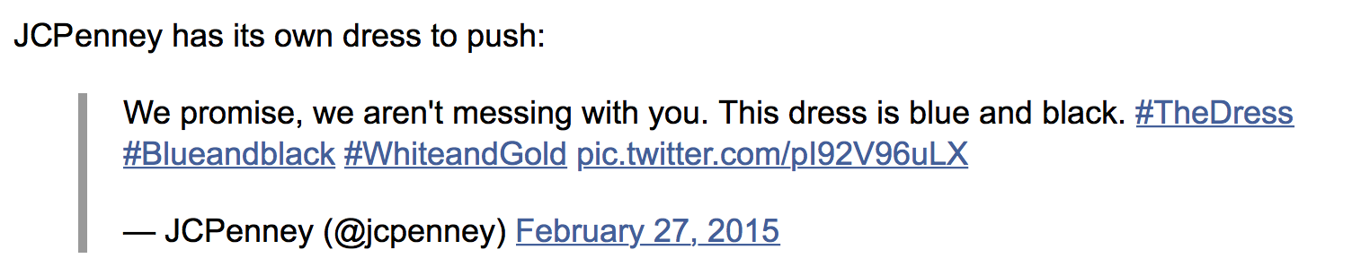
http://artport.whitney.org/commissions/thedumpster/about.html
show line graph of frequency at which they were mentioned online
e.g. black/blue white/gold dress might’ve been very popular during feburary/march, but has declined since
Also want to show context of which the memes are used (e.g. ironically, sarcastically, etc.)

Slide 5
Relaxation Space
http://www.calm.com
http://29a.ch/sandbox/2011/neonflames/
http://i.imgur.com/Huou7Gh.gif
a place to get a quick break from school / stress, slow down
different modes – breathing space, drawing space, ambient music space?

Slide 6
Domino Builder
Inspiration: https://www.tinkercad.com

Slide 7
